Slide 1

What Is Linux?
Just like Windows, iOS, and Mac OS, Linux is an operating system. In fact, one of the most popular platforms on the planet, Android, is powered by the Linux operating system, besides being the platform of choice to run desktops, servers, and embedded systems across the globe, Linux is one of the most reliable, secure and worry-free operating systems available.

Slide 2
Uses of Linux in everyday life:
From smartphones to cars, supercomputers and home appliances, home desktops to enterprise servers, the Linux operating system is everywhere. Linux has been around since the mid-1990s and has since reached a user-base that spans the globe. Linux is actually everywhere: Its in your phones, your thermostats, in your cars, refrigerators, Roku devices, and televisions. It also runs most of the Internet, all of the world’s top 500 supercomputers, and the world’s stock exchanges. But besides being the platform of choice to run desktops, servers, and embedded systems across the globe, Linux is one of the most reliable, secure and worry-free operating systems available.

Slide 3
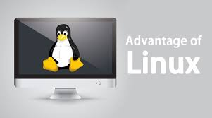
ADVANTAGES
1. Free to use (Low Cost):
Linux is freely available on the web to download and use. You need to spend a huge amount to buy the license of Windows which is not the case with Linux.
2. Open-Source:
Linux was one of the first open-source technologies. This means that you can download the source code and change it any way you like.

Slide 4

3. Various Distributions:
There are many distributions available also called bistros of Linux. It provides various choices or flavors to the users. You can select any bistros according to your needs
Popular Linux distributions include:
LINUX MINT
MANJARO
DEBIAN
UBUNTU
ANTERGOS
SOLUS
FEDORA
ELEMENTARY OS
OPENSUSE

Slide 5
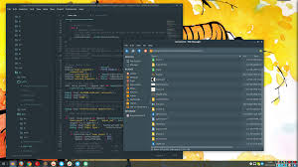
4. Customization:
A feature that gives a major advantage over other operating systems is customization. You can customize any feature, add or delete any feature according to your need as it is an open source operating system. Not only this, various wallpapers and attractive icon themes can be installed to give an amazing look to your system

Slide 6
DISADVANTAGES
1. NUMEROUS LINES OF CODE:
No operating system is as user-friendly as Microsoft Windows. There are still too many things in the Linux world that are expected to be done manually, like program installation whereas in windows the same actions can be done using a few clicks.
2. There IS A SMALLER SELECTION OF PERIPHERAL HARDWARE DRIVERS FOR LINUX:
There is a smaller selection of peripheral hardware drivers (for printers, scanners, and other devices) in Linux whereas windows support various hardware devices.

Slide 7
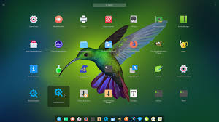
3. LACK OF SOFTWARES:
What do you look for in an operating system? For most people, the answer is probably ease of use and compatibility. I’ll look at ease of use shortly. For now, let’s focus on compatibility.
Adobe Photoshop
Microsoft Office
Dreamweaver
7-Zip
Final Cut Pro
Outlook
Irfan View

Slide 8
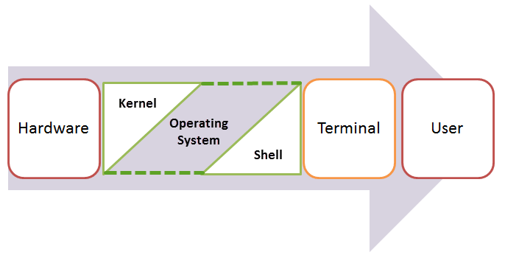
Components of Operating System(Linux):
An Operating system is made of many components, but its two prime components are:
Kernel
Shell

Slide 9
Kernel:
A Kernel is at the nucleus of a computer. It makes the communication between the hardware and software possible. While the Kernel is the innermost part of an operating system, a shell is the outermost one.
Shell:
A shell in a Linux operating system takes input from you in the form of commands, processes it, and then gives an output. It is the interface through which a user works on the programs, commands, and scripts. A shell is accessed by a terminal which runs it. The Shell wraps around the delicate interior of an Operating system protecting it from accidental damage. Hence the name Shell.

Slide 10
Shell Scripting:
Shell scripting is writing a series of command for the shell to execute. It can combine lengthy and repetitive sequences of commands into a single and simple script, which can be stored and executed anytime. This reduces the effort required by the end user.
Bash Commands:
s: Show directory contents, lists names of files.
mkdir: Creates a directory of the specified name.
cat: Display contents of a file.
cd: Change directory. Change to certain directory name if provided.
Changes to home directory if no directory specified.
pwd: Displays the name of the working directory.

Slide 11
touch: Creates a blank file with a specified name.
less: View contents of specified file, page by page.
head/tail: Displays the first/ last 10 lines of a file.
rm: Removes a specified file. This action is permanent. There is no recycle bin.
rmdir: Removes a directory.
history: Display a listing of the last commands you've run.
cp: Copy specified file to a new named file. Use -r flag to copy a directory.
mv: Rename a specified file or directory.

Slide 12
Basics
Scripts are stored in files. You can give any name and extension to a shell script, it does not matter. The important thing is that it must start with a “shebang” on the first line:
Chmod:
A file is set as executable using chmod

Slide 13

Variable:
you can set variable by using = operator
Examples:

Slide 14
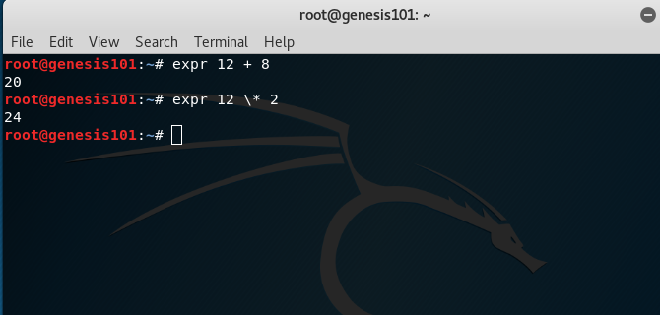
Operators
Bash implements some arithmetic operators commonly used across programming languages:
+ add
- subtract
* multiply
/ divide
% modulo (remainder of the division)
** exponentiation

Slide 15
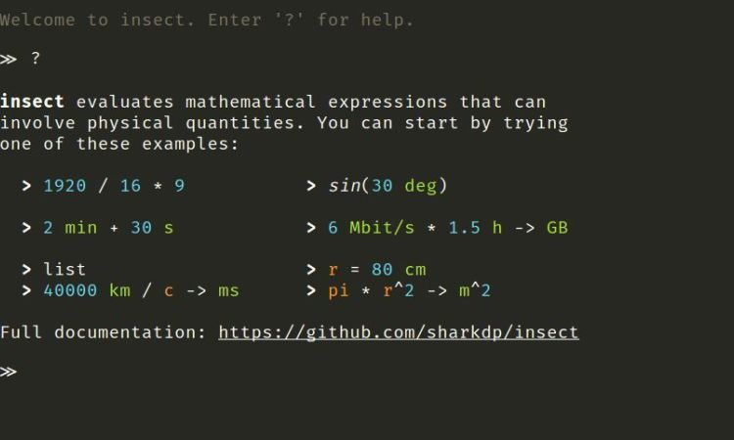
You can compare values using
<
<=
==
>=
>
You can also use these comparison operators:
-lt lower than
-gt greater than
-le lower or equal than
-ge greater or equal than
-eq equal to
-ne not equal to

Slide 16
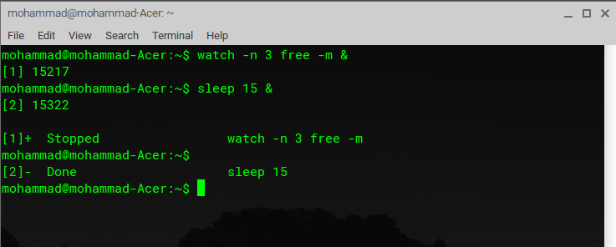
Logical operators:
&& logical AND
|| logical OR
These shortcuts allow to perform an arithmetic operation and then an assignment:
+=
-=
*=
/=
%=
There are some more operators, but those are the most common ones.

Slide 17

Print to the screen
You can print anything to the screen using the Echo command:

